Slide 1
CDC IP Potential Issues
Yong Kim
Hartej Singh
2015 WW42

Slide 2
CDC (Clock Domain Controller): Potential Issues
Two potential issues:
These are applicable to the CDC (Clock Domain Controller) sub-IP – part of PGCB family of sub-IPs
Not seen in any Si; considered to be very low risk; information is being provided proactively to ensure full transparency
Any IP block using the CDC should be aware of these issues
When meta-stability modeling is enabled (i.e. -1, +1 mode), IP blocks may see one or both of the issues below.
Description
Issue 1: Failure to enter IP-Accessible PG state (may result in higher SOC power)
CDC does not assert pwrgate_ready signal (even though conditions are appropriate), hence prevents PGCB from entering PG state.
NOTE: CDC does not hang but exits this state when the IP next asserts one or more of the input gclk_req* signals to the CDC.
https://hsdes.intel.com/home/default.html#article?id=1503996414
Issue 2: Failure to enter IP-Inaccessible PG state (release 1.20 of PGCB/CDC only)
If an IP keeps one or more gclk_req_* inputs asserted after receiving ForcePwrgatePOK message, under certain metastability modeling conditions, CDC may prevent PG entry: Potential hang (global reset cause).
https://hsdes.intel.com/home/default.html#article?id=1504001217

Slide 3
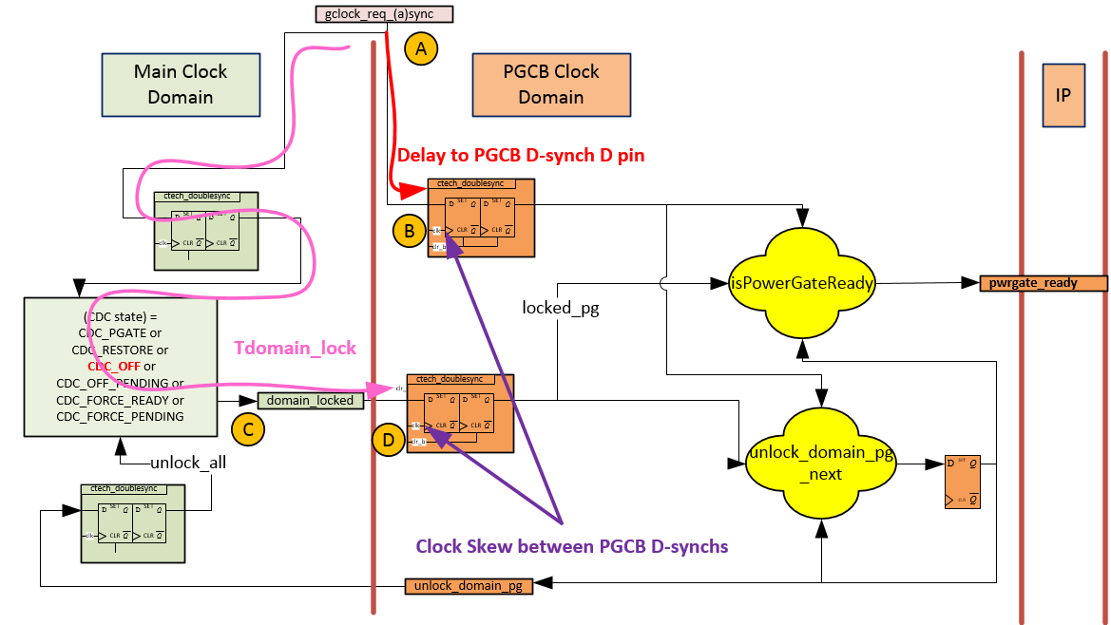
Issue 1: IP-Accessible PG Issue

Slide 4
Issue 1: Recommendation for IP blocks
Determine the minimum time between the gclock_req_(a)synch input negation to domain_lock assertion (CDC_PGATE state).
CDC provides configuration inputs for IPs to program delays in some state transition. Following two configuration input can be programmed to avoid the race condition.
cfg_clkgate_holdoff[3:0], cfg_pwrgate_holdoff[3:0]
Check if the calculated minimum delay is greater than the minimum PGCB cycle required to avoid this issue
Min PGCB Cycle = 2 (recommended) :covers (-1, +1), (-1, 0) and (0, +1) delay models
Min PGCB Cycle = 1 (minimum) :covers only (-1, 0) or (0, +1) delay models
If Step 2 is True: No action required (you can stop here)
If Step 2 is False:
Increase the POR value for the counters given above until Step 2 is true.
If the value is not programmable, or the counter bits (specified through ITBITS parameter) are limited
If project RTL is frozen, see next foil.
If project RTL is not frozen, the IP should change the value of the counters (preferably make it programmable) and/or update value of ITBITS parameter so that equation in Step 2 holds true.
T_{domain_lock} = Time between gclock_req_async fall to domain_locked rise in Main Clock Domain
= (2^clkgate_holdoff+2^pwrgate_holdoff+8) * Func. Clk period
T_{domain_lock} >= (Min PGCB Cycle) * (PGCB_period)

Slide 5
Issue 1: Recommendation for IP blocks
Scenario: Following 3 conditions are true
SOC RTL is frozen
IP Step 2 (from previous foil) is not True
The counter values (see previous foil) are not programmable
Check with SD team for the given SOC if the following is true (Will not fail if true).
T_{domain_lock} > ABS(clock skew between D-sync Flops given in figure for Issue 1)
+ Delay to PGCB D-sync D pin
Where Min T_{domain_lock} is greater than (2^clkgate_holdoff+2^pwrgate_holdoff+8) * Func. Clk period
*Note that T_{domain_lock} is greater than 10 main clk periods
If this is not true
Option 1: SD Fix
Option 2: Get hot fix RTL from CDC team and perform ECO (relatively simple change)

Slide 6
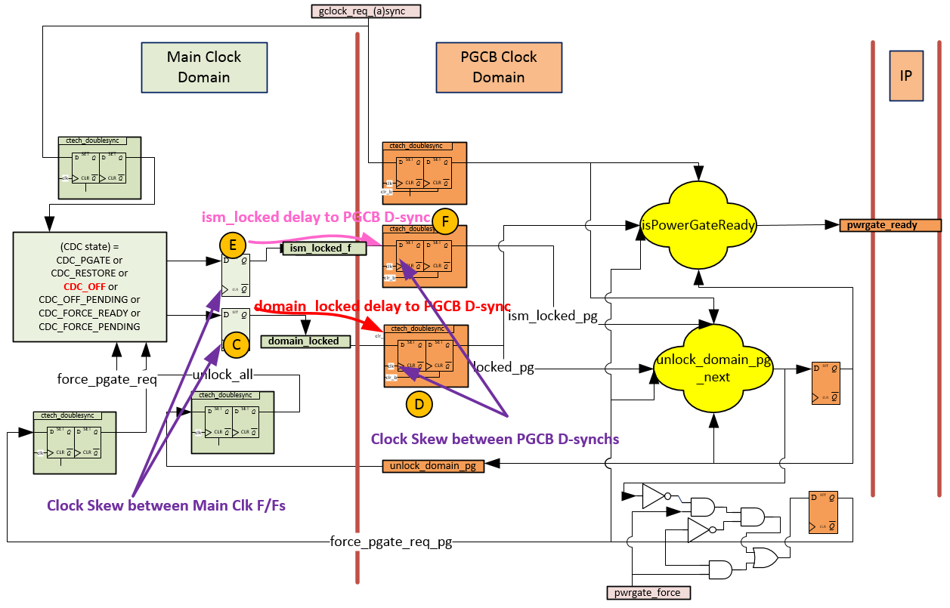
Issue 2: IP-Inaccessible PG (rev 1.20)
If gclk_req_* remains high during IP-Inaccessible PG entry
If domain_locked (0->1) gets captured 1 PGCB clock earlier than ism_locked_f (0->1).

Slide 7
Issue 2: Recommendation for IP blocks
For all IP blocks that use the CDC (PGCB rev 1.20 release), please check with SOC Physical design team (SD team) for the following:
ism_locked delay to D-synch < (domain_locked delay to D-synch) + (3*Main Clock Period)
- ABS(clock skew Main Clk F/Fs) - ABS(clock skew D-syncs)
** clock uncertainty should be accounted for.
**ism_locked asserts 3 functional clk cycles earlier than domain_locked
If this is not true
Option 1: SD Fix
Option 2: Please contact PGCB/CDC team (contact: Yong J Kim) for hot fix RTL and perform RTL change/ECO as applicable (relatively simple change)

